Slide 1
CAR PRICE PREDICTION
DATA MINING PROJECT
YEHONATAN MESIKA & DANIEL ZIV

Slide 2
Research Question
Can we predict a price
of a used car in USA?

Slide 3

Scraping data using a crawler
We scraped information from USA Craigslist – used cars & trucks list https://www.craigslist.org/about/sites
Extracting regions
Extracting cars
Extracting information
First, we extracted a list of the regions urls
Second, we extracted the cars from every region
Third, we extracted the information about every car

Slide 4
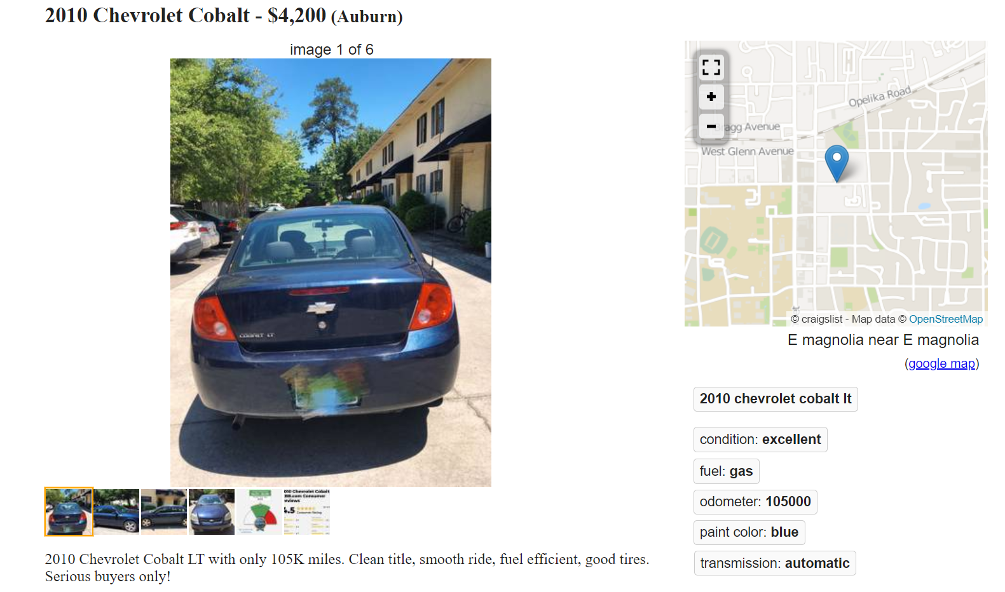
The information we scraped
1
Region name
6
Car condition
2
Car manufacturer and model name
7
Car fuel type
3
Year of manufacture
8
Car transmission type
4
Car price
9
Car color
5
Car odometer in miles
Example of a car page:

Slide 5
Handling the data
At first, we analyzed the data we extracted.
The year of the manufacture was combined with the car manufacturer name and model in the same string so we split the year from the string and converted it to int type.
Then, we started to remove rows with NULL information and remove outliers.
After cleaning the data frame we checked our information for a big groups of misspellings, such as “vw” instead of Volkswagen and we corrected them. In addition, we removed wandering spaces, such as “ like new”, and turned it to “like new”.

Slide 6

EDA & Visualization
~170,000
136
Cars
Regions

Slide 7
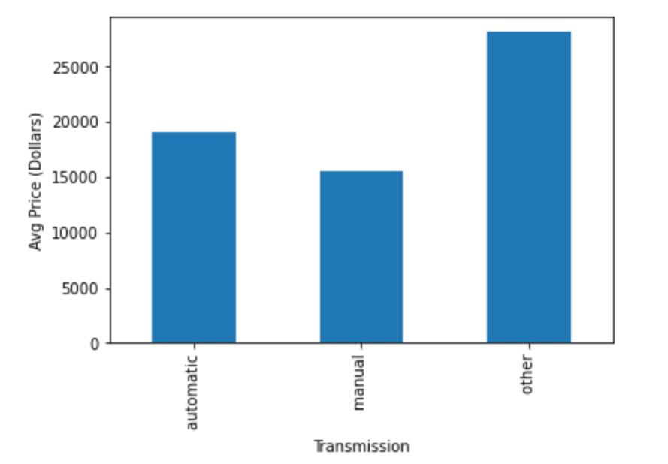
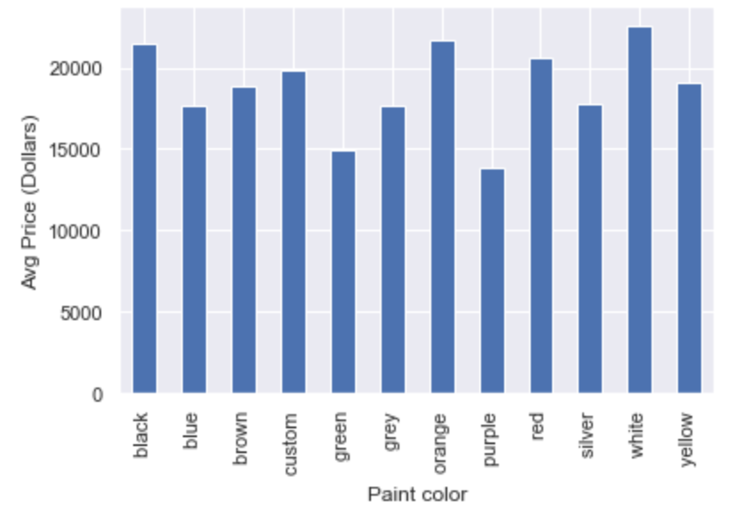
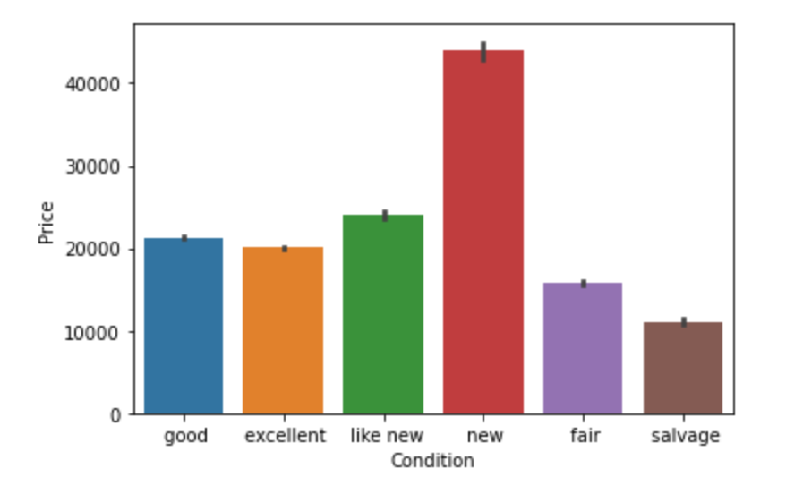
We checked the correlation of the price with the transmission types, the price with the condition types and the price with the paint color. We can see that there is a correlation between those parameters
Its obvious that a new car will have a higher price, and a salvage car will have a lower price.
There is not a great difference between the other conditions as we can see
We can see that the price of electric and hybrid transmission is higher than manual and automatic
We can see that there is not a great correlation between the colors with the price

Slide 8
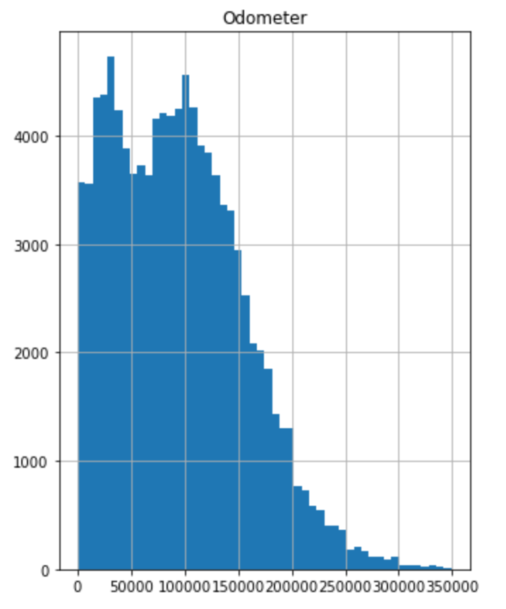
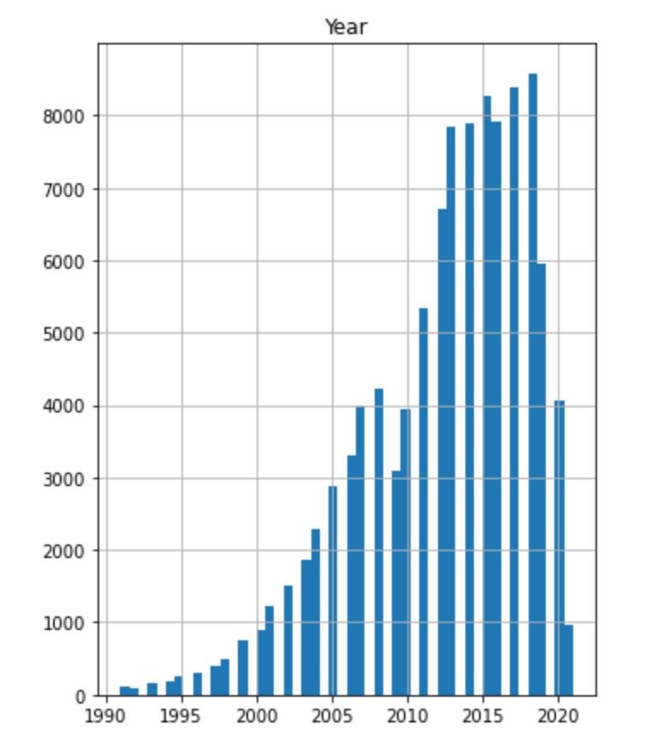
We checked the correlation of the price with the car odometer, and we can see that the lower the mileage, the higher the price
We checked the correlation of the price with the car year, and we can see that the higher the year, the higher the price

Slide 9
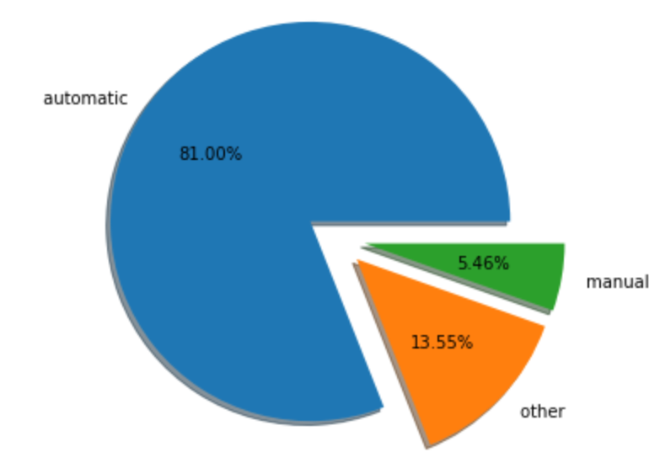
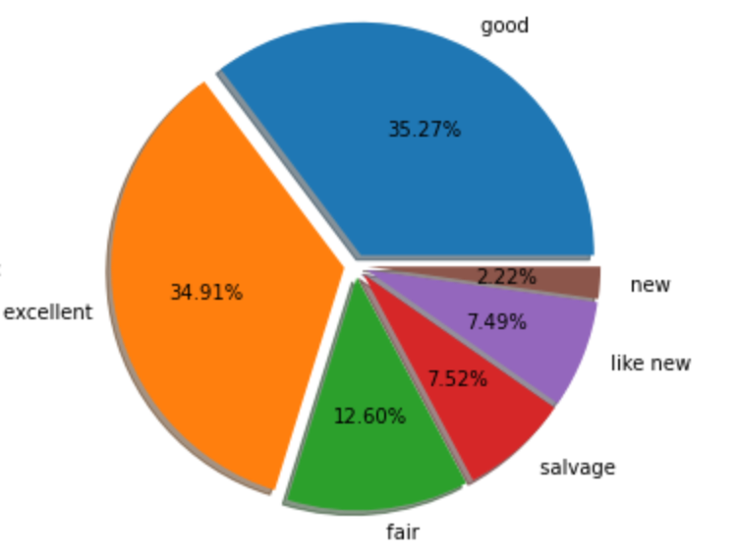
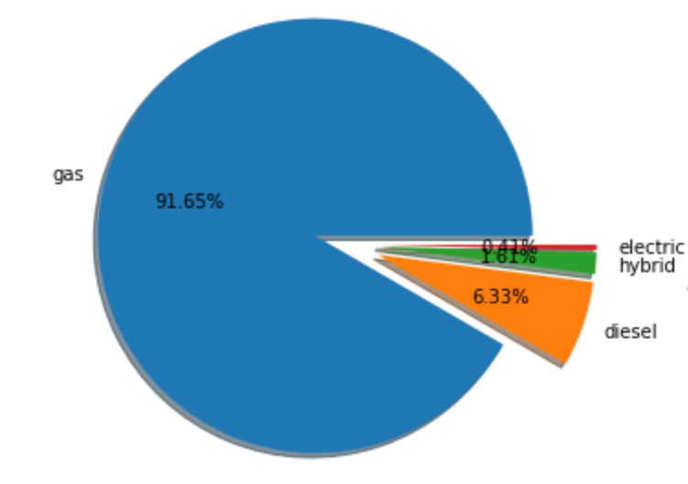
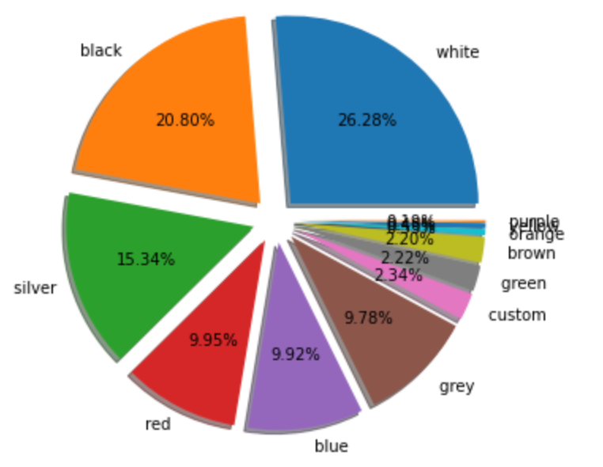
Transmission pie chart
Condition
pie chart
1
3
Fuel type
pie chart
Paint color
pie chart
2
4

Slide 10
Model and Machine Learning
Model
Paint color
Price
Odometer

Slide 11
At first we thought which model is more suitable to our database.
Our project question is whether we can predict a price of a used car, so we need to focus on the price which is a numeric value.
After we understand that, we normalized all our features so we could use a prediction model such as Linear Regression.
Therefore we chose the features with the highest correlation with the price, which are: model, car age, region, transmission, fuel type, condition and odometer.
Paint color had the worst correlation with the price so we dropped it from the model.

Slide 12
Step 1: We dropped the paint color column from our data frame, because it correlation was not good.
Step 2: We applied machine learning process:
Dividing our data frame: features and label (price).
Dividing features and label to train and test (train = 80%, test = 20%).
Fit & Predict
Accuracy
Step 3: Feature Engineering:
We found out the Correlation between all features.
We dropped the year column (car age instead).
We merged all dummies features into our data frame.
Then, we dropped the original columns.

Slide 13

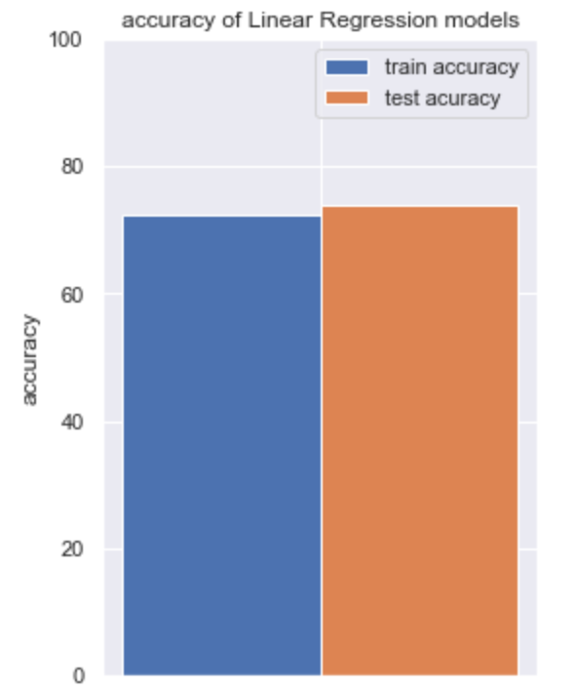
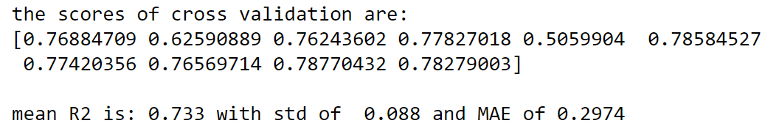
Results
We evaluated the accuracy of our model using the R-Squared method.
The closer R-Squared is to 1, the lower the error of the model is.
In our case, R-Squared is 0.74, this result relative to linear regression is very good as we know that R-Squared result with linear regression model higher than 0.5 is a fine prediction.
To verify our R-Squared result we used cross validation method and we came to know that the model predicts the result properly because the standard deviation is very low .

Slide 14

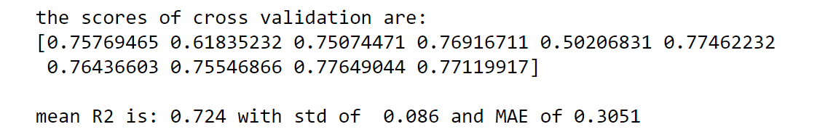
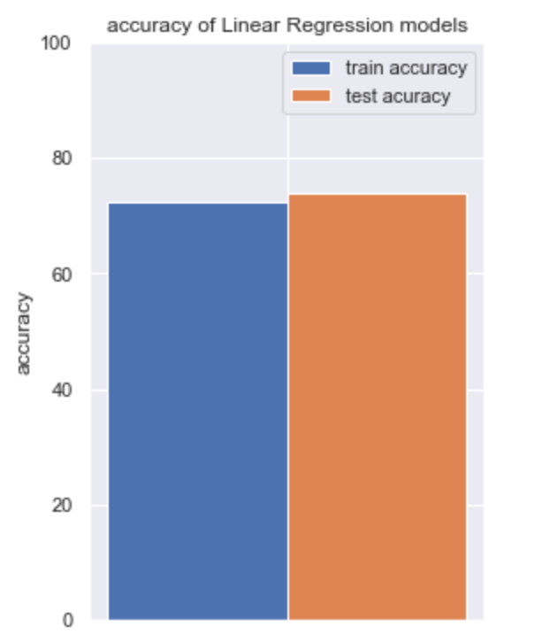
After we got the results we checked if we add the paint color to our model we will get a better results. As you can see the results were not the same but were not very different from each other.
R-Squared with paint color
R-Squared without paint color

Slide 15
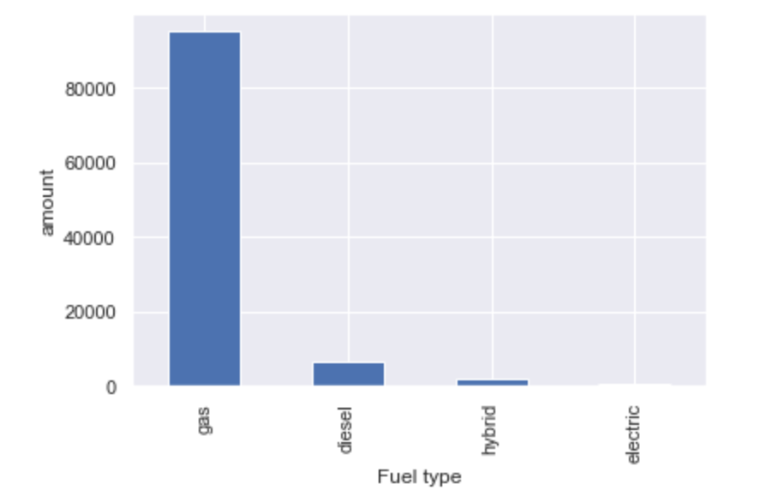
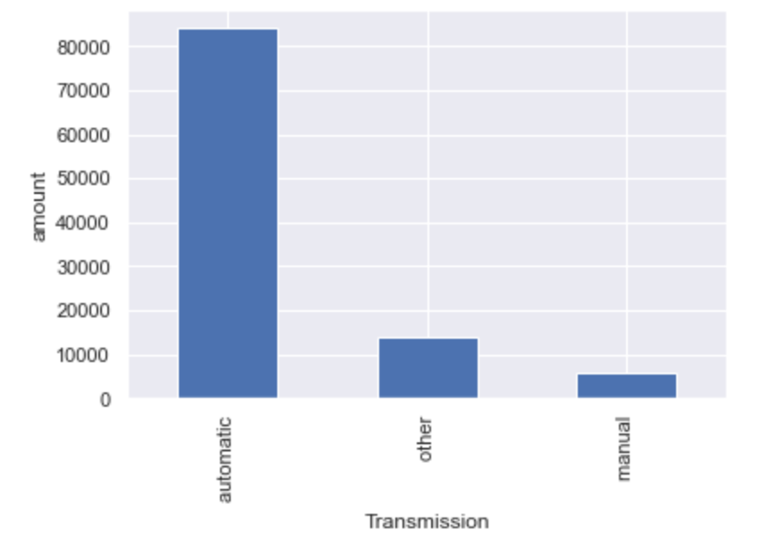
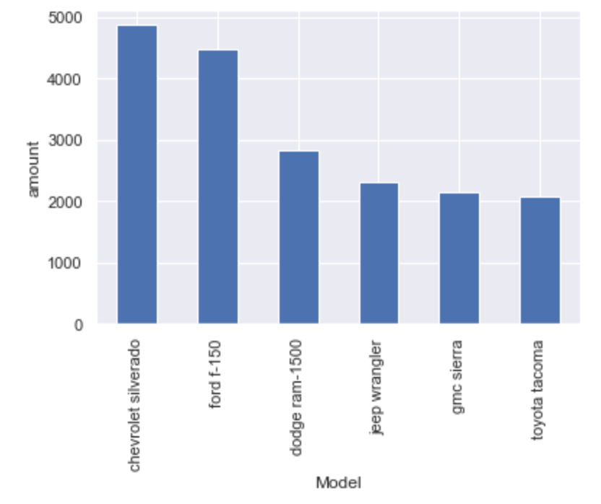
Additional data
Best-selling vehicles
Most common type of fuel
Most common type of transmission

Slide 16
The future profit we get from the model is that the model allows us to predict the price of vehicles according to certain features. A person who is interested in selling his vehicle can enter the features of his vehicle into the model and the it will predict the approximate price of the vehicle according to all the vehicle data in the model.

Slide 17
Conclusion
In conclusion, we have seen that with the help of AI it is possible to predict the prices of used vehicles according to the provision of certain features.
While crawling dynamic data by the crawler we encountered data issues that were no longer there because they were deleted from the site before we could reach them even though we had already saved the link to them.

